Slide 1
SQL Server
Writing Scripts and Batches
In all slides, db=database

Slide 2
Script Basics
Scripts contain a group of related commands such as those you have already been using (SELECT, ALTER, etc.)
Scripts are usually treated as a unit, you are normally executing the entire script or nothing at all.
A script technically isn’t a script until you store it in a file where it can be pulled up and reused.
SQL scripts are stored as text files and have the file extension of .sql
They can make use of both system functions and local variables .

Slide 3
A Script Example
USE Northwind
DECLARE @Ident int
INSERT INTO Orders
(CustomerID, OrderDate)
VALUES
(‘ALFKI’, DateADD(day, -1, GETDATE()))
SELECT @Ident = @@IDENTITY
INSERT INTO [Order Details]
(OrderID, ProductID, UnitPrice, Quantity)
VALUES
(@Ident, 1, 50, 25)
SELECT ‘The OrderID of the INSERTed row is ‘ + CONVERT(varchar(8), @Ident)

Slide 4
The USE Statement
The USE statement sets the current database.
This affects any place where we are making use of default values for the database portion of our fully qualified object name.
If your intent is to have a general-purpose script, then leaving out the USE statement might actually be helpful.
If the script is database-specific, it’s best to include the USE statement.

Slide 5
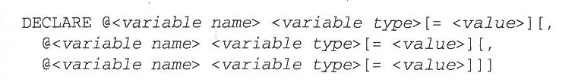
Declaring Variables
You can create variables in sql as in other programming languages
The DECLARE syntax:
You can declare just one variable at a time, or several.
Variables will always have a default value of NULL

Slide 6

Setting the Value in Your Variables
There are two ways to set the value of your variables: using a SET or using a SELECT
Using SET:
SET is usually used for setting variables in the fashion that you would see in more procedural languages.

Slide 7
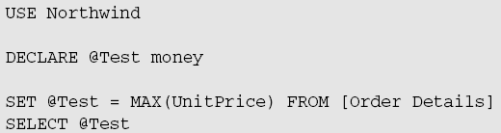
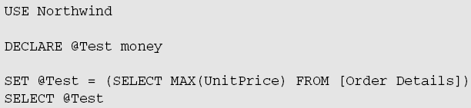
Setting the Value in Your Variables
Notice that these are all straight assignments that use either explicit values or another variable.
With a SET, you cannot assign a value to a variable from a query—you have to separate the query from the SET. For example:
Will cause error:
Instead:

Slide 8
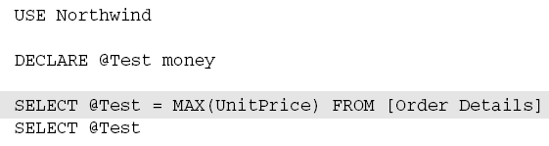
Setting Variables Using SELECT
SELECT is usually used to assign variable values when the source of the information you’re storing in the variable is from a query.

Slide 9
Set or Select?
Use SET when you are performing a simple assignment of a variable—where your value is already known in the form of an explicit value or some other variable.
Use SELECT when you are basing the assignment of your variable on a query.

Slide 10
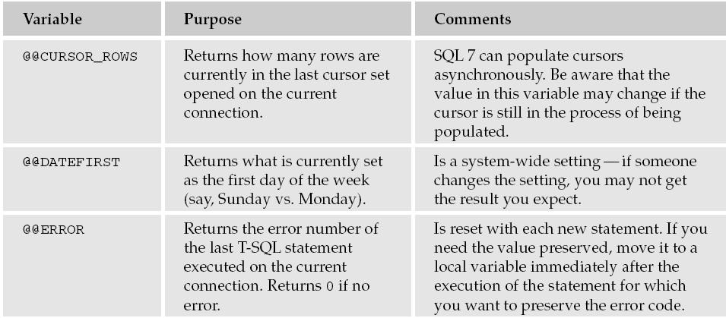
System Functions
There are over 30 parameterless system functions available – here are some:

Slide 11
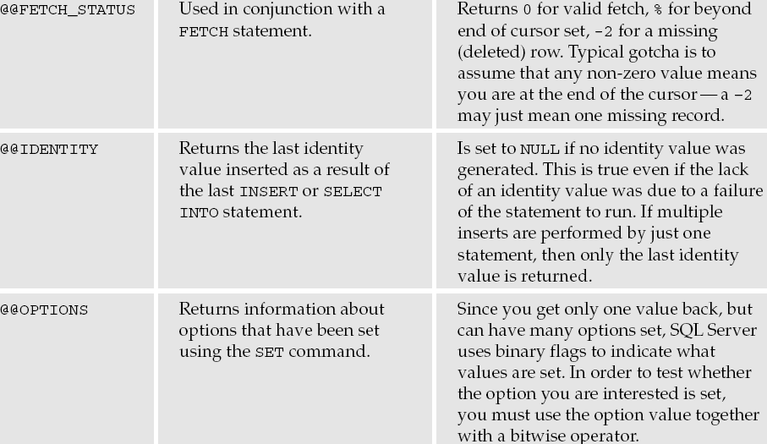
System Functions cont.

Slide 12
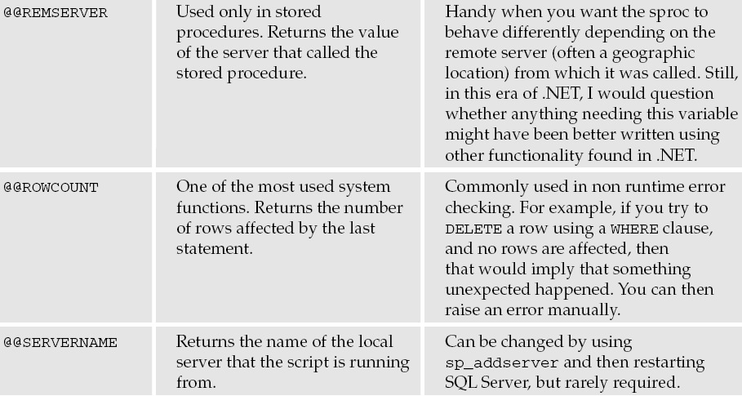
System Functions cont.

Slide 13
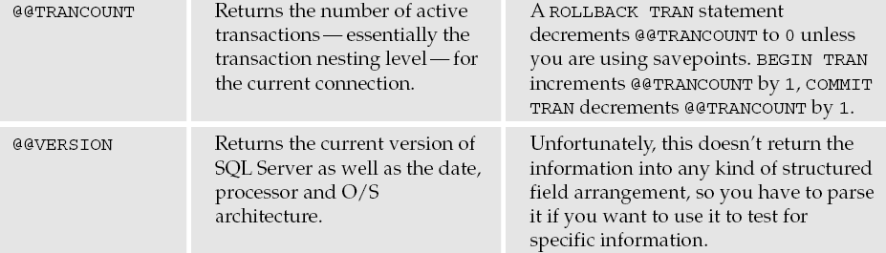
System Functions cont.

Slide 14
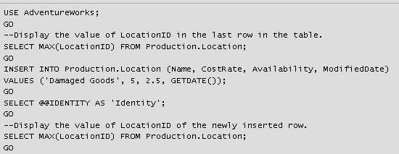
@@IDENTITY
Returns the last-inserted identity value.
The following example inserts a row into a table with an identity column (LocationID) and uses @@IDENTITY to display the identity value used in the new row.

Slide 15
@@IDENTITY cont’d
Note that @@IDENTITY changes with every INSERT. If the table that you are inserting into does not have an identity column, then @@IDENTITY will be set to NULL.

Slide 16
A Few Things About Scripts…
Note that you can use PRINT statements to print out information to the Messages window
We will cover in detail later, but an example in this chapter illustrates that you can use IF statements in your scripts
IF 1 = 1
PRINT ‘1=1’
ELSE
PRINT ‘1 != 1’

Slide 17
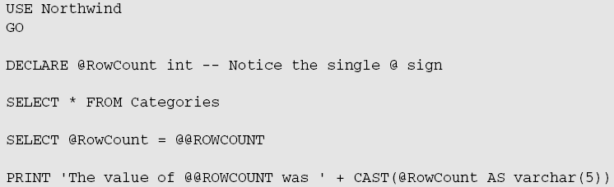
@@ROWCOUNT
What if we need to programmatically know how many rows were affected by a query?
This again shows us all the rows, but notice the new line that we got back:

Slide 18
Batches
A batch is a grouping of T-SQL statements into one logical unit.
All of the statements within a batch are combined into one execution plan, so all statements are parsed together and must pass a validation of the syntax or none of the statements will execute.
However, if a statement fails at runtime, then all statements until that statement that generated the error have already been run.

Slide 19
Multiple Batches
All the scripts we have run up to this point are made up of one batch each
To separate a script into multiple batches, we make use of the GO statement.

Slide 20
GO
A GO statement causes all statements since the beginning of the script or the last GO statement (whichever is closer) to be compiled into one execution plan and sent to the server independent of other batches.

Slide 21

GO – Placement within Script
The GO command should be on its own line of the script.
Technically you can start a new batch on the same line after the GO command, but you’ll find this puts a serious damper on readability.
T-sql statements cannot precede the GO statement on a single line, or the GO statement will often be misinterpreted and cause either a parsing error or some other unexpected result.

Slide 22
Errors in Batches
Errors in batches fall into two categories
Syntax errors
Runtime errors
If the query parser finds a syntax error, processing of that batch is cancelled immediately. Since syntax checking happens before execution, none of the batch will be executed.
For runtime errors, any statement that has already executed before the runtime error was encountered is already done, so anything that statement did will remain intact unless it is part of an uncommitted transaction (Chapter 14).

Slide 23
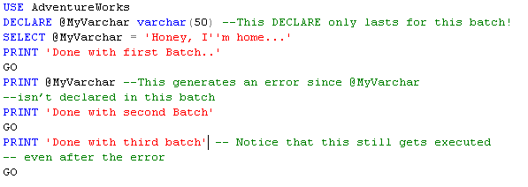

Each Batch Is Sent to the Server Separately
Because each batch is processed independently, an error in one batch does not stop another batch from running.

Slide 24
When to Use Batches
Batches have several purposes, but they all have one thing in common—they are used when something has to happen either before or separately from everything else in your script.

Slide 25
When to use Batches cont.
There are several commands that absolutely must be part of their own batch.
If you want to combine any of these statements with other statements in a single script, then you will need to break them up into their own batch by using a GO statement. These include:
CREATE DEFAULT
CREATE PROCEDURE
CREATE RULE
CREATE TRIGGER
CREATE VIEW

Slide 26
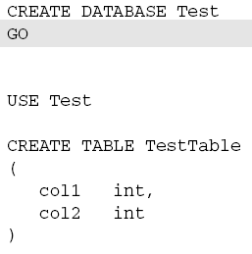
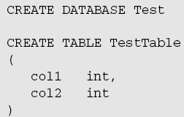
Using Batches to Establish Precedence
Use batches when one task needs to be completely done before the next task starts.
Will not work as expected.
Instead, use batch.

Slide 27
SQLCMD
SQLCMD is a utility that allow you to run scripts from a command prompt in a Windows command box.
This can be very nice for executing conversion or maintenance scripts, as well as a quick and dirty way to capture a text file.

Slide 28
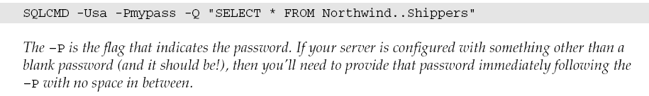
SQLCMD cont.

Slide 29
EXEC
Let’s build an example in the Northwind database by creating a dummy table to grab our dynamic information out of:
USE Northwind
GO
--Create The Table. We’ll pull info from here for our dynamic SQL
CREATE TABLE DynamicSQLExample
(
TableID int IDENTITY NOT NULL
CONSTRAINT PKDynamicSQLExample
PRIMARY KEY,
TableName varchar(128) NOT NULL
)
GO
/* Populate the table. In this case, We’re grabbing every user
** table object in this database */
INSERT INTO DynamicSQLExample
SELECT TABLE_NAME
FROM Information_Schema.Tables
WHERE TABLE_TYPE = 'BASE TABLE'

Slide 30
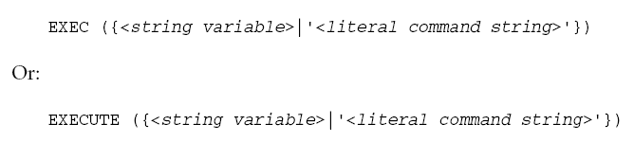
EXEC Command
Saving scripts is great, but what if you don’t know what you need to execute until runtime?
SQL Server allows us to build our SQL statement on-the-fly using string manipulation.

Slide 31
EXEC cont.
What we now have is a list of all the tables in our current database.
Now let’s say that we wanted to select some data from one of the tables, but we wanted to identify the table only at run time by using its ID.
/* First, declare a variable to hold the table name. Remember,
** object names can be 128 characters long
*/
DECLARE @TableName varchar(128)
-- Now, grab the table name that goes with our ID
SELECT @TableName = TableName
FROM DynamicSQLExample
WHERE TableID = 14
-- Finally, pass that value into the EXEC statement
EXEC ('SELECT * FROM ' + @TableName)

Slide 32
The Scope of EXEC
The EXEC statement runs under a separate scope than the code that calls.
The calling code can’t reference variables inside the EXEC statement, and the EXEC can’t reference variables in the calling code after they are resolved into the string for the EXEC statement.

Slide 33
Use of Functions in EXEC
Concatenation that requires a function call must be performed on the EXEC string prior to actually calling the EXEC statement—you can’t do the concatenation of function in the same statement as the EXEC call.

Slide 34
Use of Functions in EXEC cont’d
USE Northwind
--This won’t work
DECLARE @NumberOfLetters int
SET @NumberOfLetters = 15
EXEC(‘SELECT LEFT(CompanyName, ‘ + CAST(@NumberOfLetters AS Varchar) + ‘) AS ShortName
FROM Customers’)
GO
--But this does
DECLARE @NumberOfLetters AS int
SET @NumberOfLetters = 15
DECLARE @str AS varchar(255)
SET @str = ‘SELECT LEFT(CompanyName, ‘ + CAST(@NumberOfLetters AS varchar) + ‘) AS ShortName FROM Customers’
EXEC(@str)

Slide 35
EXEC Notes
It runs under the same security context as the current user—not that of the calling object.
It runs under the same connection and transaction context as the calling object.
EXEC can not be used inside a User Defined Function.

